Slide 1
Theory of Computation
CSE 3101
Lecture # 6
Md. Manowarul Islam
Lecturer, Dept of CSE
Jagannath University

Slide 2
NFA to DFA by subset construction
Let N = {Q_{N},∑,δ_{N},q₀,F_{N}}
Goal: Build D={Q_{D},∑,δ_{D},{q₀},F_{D}} s.t. L(D)=L(N)
Construction:
  Q_{D}= all subsets of Q_{N} (i.e., power set)
  F_{D}=set of subsets S of Q_{N} s.t. S∩F_{N}≠Φ
  δ_{D}: for each subset S of Q_{N} and for each input symbol a in ∑:
    δ_{D}(S,a) = U δ_{N}(p,a)
p in s

Slide 3
NFA to DFA construction: Example
L = {w | w ends in 01}
NFA:
DFA:
0,1
0
1
q₀
q₁
q₂
δ_{D}
Ø
{q₀}
{q₁}
*{q₂}
{q₀,q₁}
*{q₀,q₂}
*{q₁,q₂}
*{q₀,q₁,q₂}
δ_{N} | 0 | 1
q₀ | {q₀,q₁} | {q₀}
q₁ | Ø | {q₂}
*q₂ | Ø | Ø
0. Enumerate all possible subsets

Slide 4
NFA to DFA construction: Example
L = {w | w ends in 01}
NFA:
DFA:
0,1
0
1
q₀
q₁
q₂
δ_{D} | 0 | 1
Ø | Ø | Ø
{q₀} | {q₀,q₁} | {q₀}
{q₁} | Ø | {q₂}
*{q₂} | Ø | Ø
{q₀,q₁} | {q₀,q₁} | {q₀,q₂}
*{q₀,q₂} | {q₀,q₁} | {q₀}
*{q₁,q₂} | Ø | {q₂}
*{q₀,q₁,q₂} | {q₀,q₁} | {q₀,q₂}
δ_{D}
Ø
{q₀}
{q₁}
*{q₂}
{q₀,q₁}
*{q₀,q₂}
*{q₁,q₂}
*{q₀,q₁,q₂}
δ_{N} | 0 | 1
q₀ | {q₀,q₁} | {q₀}
q₁ | Ø | {q₂}
*q₂ | Ø | Ø
0. Enumerate all possible subsets
Determine transitions

Slide 5
NFA to DFA construction: Example
L = {w | w ends in 01}
NFA:
DFA:
0,1
0
1
q₀
q₁
q₂
δ_{D} | 0 | 1
Ø | Ø | Ø
{q₀} | {q₀,q₁} | {q₀}
{q₁} | Ø | {q₂}
*{q₂} | Ø | Ø
{q₀,q₁} | {q₀,q₁} | {q₀,q₂}
*{q₀,q₂} | {q₀,q₁} | {q₀}
*{q₁,q₂} | Ø | {q₂}
*{q₀,q₁,q₂} | {q₀,q₁} | {q₀,q₂}
δ_{D} | 0 | 1
{q₀} | {q₀,q₁} | {q₀}
{q₀,q₁} | {q₀,q₁} | {q₀,q₂}
*{q₀,q₂} | {q₀,q₁} | {q₀}
δ_{N} | 0 | 1
q₀ | {q₀,q₁} | {q₀}
q₁ | Ø | {q₂}
*q₂ | Ø | Ø
0. Enumerate all possible subsets
Determine transitions
2. Retain only those states
reachable from {q₀}

Slide 6
NFA to DFA construction: Example
Idea: To avoid enumerating all of
power set, do
“lazy creation of states”
L = {w | w ends in 01}
1
0
NFA:
DFA:
{q₀}
0
{q₀,q₁}
1
{q₀,q₂}
0,1
0
0
1
1
q₀
q₁
q₂
δ_{D} | 0 | 1
Ø | Ø | Ø
{q₀} | {q₀,q₁} | {q₀}
{q₁} | Ø | {q₂}
*{q₂} | Ø | Ø
{q₀,q₁} | {q₀,q₁} | {q₀,q₂}
*{q₀,q₂} | {q₀,q₁} | {q₀}
*{q₁,q₂} | Ø | {q₂}
*{q₀,q₁,q₂} | {q₀,q₁} | {q₀,q₂}
δ_{D} | 0 | 1
{q₀} | {q₀,q₁} | {q₀}
{q₀,q₁} | {q₀,q₁} | {q₀,q₂}
*{q₀,q₂} | {q₀,q₁} | {q₀}
δ_{N} | 0 | 1
q₀ | {q₀,q₁} | {q₀}
q₁ | Ø | {q₂}
*q₂ | Ø | Ø
0. Enumerate all possible subsets
Determine transitions
2. Retain only those states
reachable from {q₀}

Slide 7
NFA to DFA: Repeating the example using LAZY CREATION
L = {w | w ends in 01}
NFA:
DFA:
0,1
0
1
q₀
q₁
q₂
δ_{N} | 0 | 1
q₀ | {q₀,q₁} | {q₀}
q₁ | Ø | {q₂}
*q₂ | Ø | Ø
δ_{D} | 0 | 1
{q₀} | {q₀,q₁} | {q₀}
{q₀,q₁} | {q₀,q₁} | {q₀,q₂}
*{q₀,q₂} | {q₀,q₁} | {q₀}
Main Idea:
Introduce states as you go
(on a need basis)

Slide 8
NFA to DFA: Repeating the example using LAZY CREATION
L = {w | w ends in 01}
NFA:
DFA:
0,1
0
1
q₀
q₁
q₂
δ_{N} | 0 | 1
q₀ | {q₀,q₁} | {q₀}
q₁ | Ø | {q₂}
*q₂ | Ø | Ø
δ_{D} | 0 | 1
{q₀} | {q₀,q₁} | {q₀}
{q₀,q₁} | {q₀,q₁} | {q₀,q₂}
*{q₀,q₂} | {q₀,q₁} | {q₀}
Main Idea:
Introduce states as you go
(on a need basis)

Slide 9
NFA to DFA: Repeating the example using LAZY CREATION
L = {w | w ends in 01}
1
0
NFA:
DFA:
{q₀}
0
{q₀,q₁}
1
{q₀,q₂}
0,1
0
0
1
1
q₀
q₁
q₂
δ_{N} | 0 | 1
q₀ | {q₀,q₁} | {q₀}
q₁ | Ø | {q₂}
*q₂ | Ø | Ø
δ_{D} | 0 | 1
{q₀} | {q₀,q₁} | {q₀}
{q₀,q₁} | {q₀,q₁} | {q₀,q₂}
*{q₀,q₂} | {q₀,q₁} | {q₀}
Main Idea:
Introduce states as you go
(on a need basis)

Slide 10
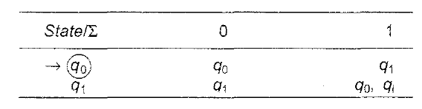
Example

Slide 11
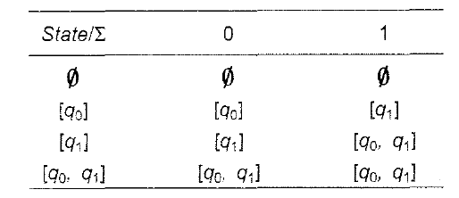
Example

Slide 12
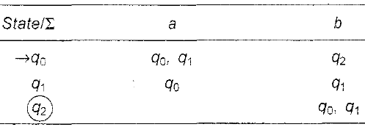
Example

Slide 13
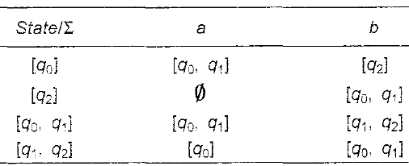
Example

Slide 14
Differences: DFA vs. NFA
DFA
All transitions are deterministic
  Each transition leads to exactly one state
For each state, transition on all possible symbols (alphabet) should be defined
Accepts input if the last state is in F
Sometimes harder to construct because of the number of states
NFA
Some transitions could be non-deterministic
  A transition could lead to a subset of states
Not all symbol transitions need to be defined explicitly (if undefined will go to a dead state – this is just a design convenience, not to be confused with “non-determinism”)
Accepts input if one of the last states is in F
Generally easier than a DFA to construct

Slide 15
END

